Slide 1
The Relationship between
Gun Laws and Gun Violence using
Machine Learning
By
Aryan Deorah (AOS) Chris Goodhart (AOS)

Slide 2
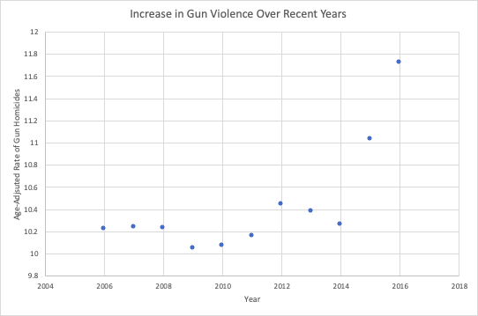
Recent Gun Violence in America
← Data taken from WISQARS/CDC

Slide 3
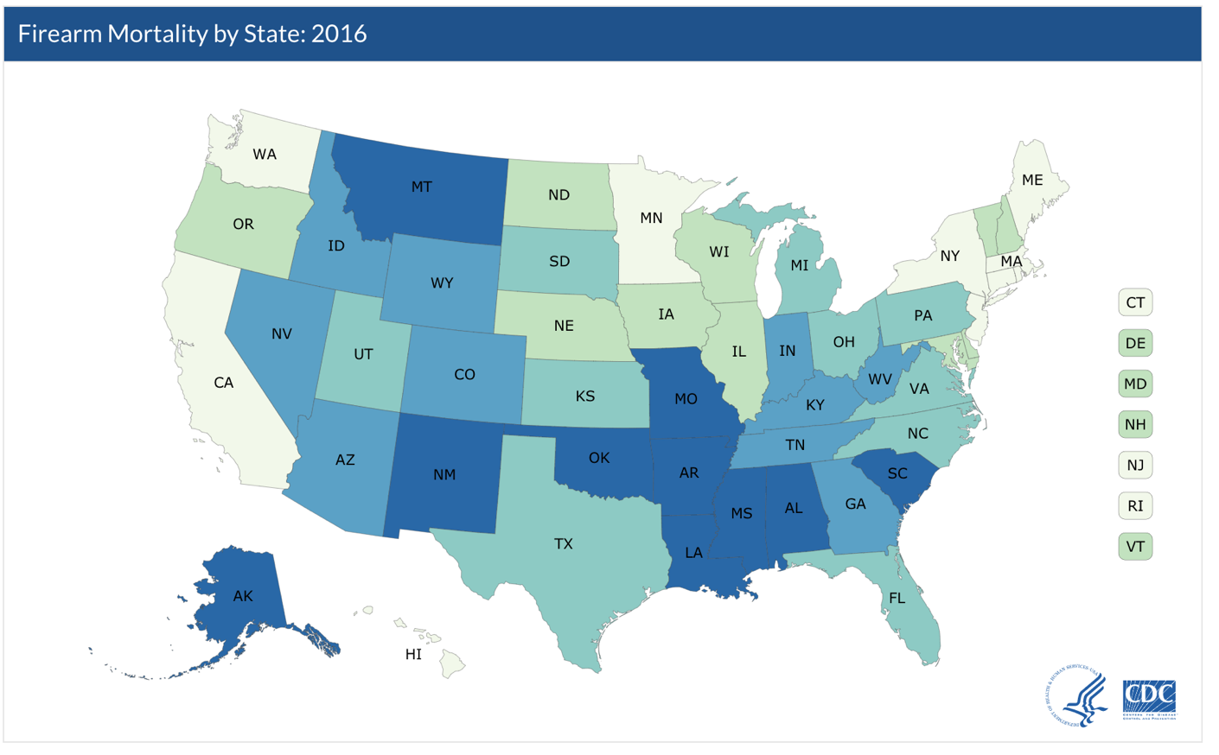
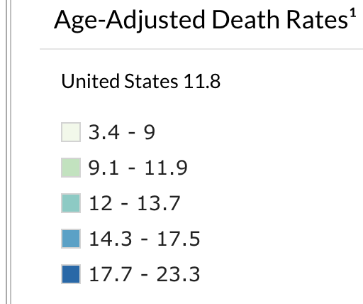
Gun Death Rates by State
◀From CDC
https://www.cdc.gov/nchs/pressroom/sosmap/firearm_mortality/firearm.htm

Slide 4
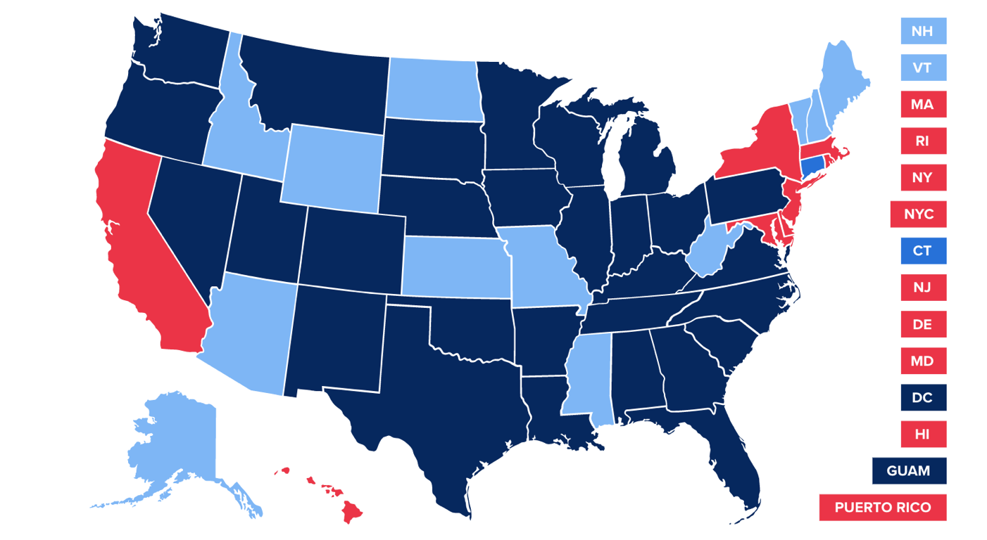
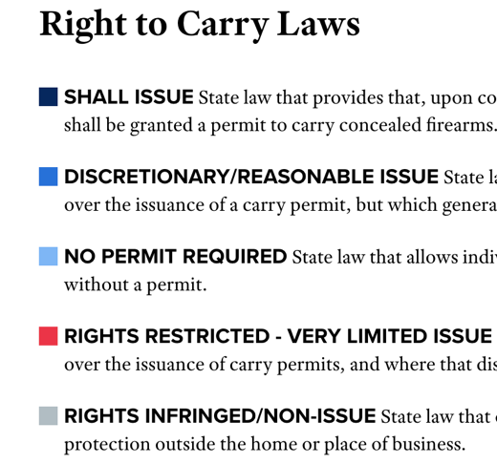
Laws by State
◀From NRA-ILA
https://www.nraila.org/gun-laws/

Slide 5
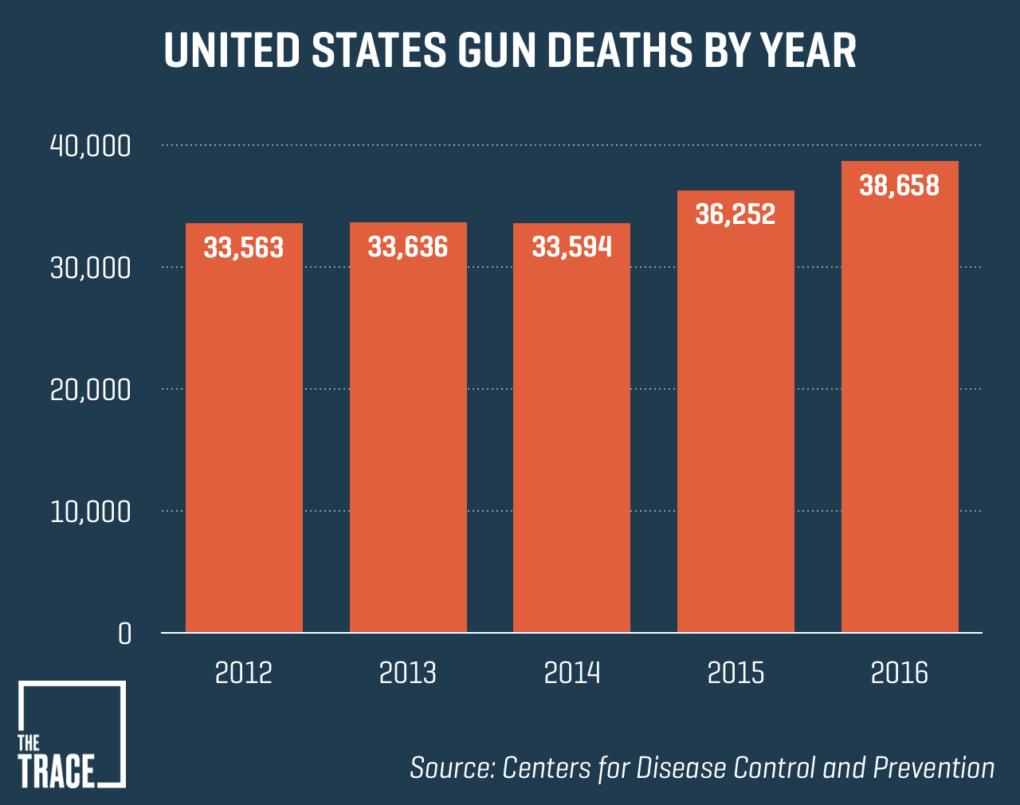
Purpose
• Find best model to recommend firearm laws that impact gun violence
• 1996: CDC banned from advocating for gun control
https://www.thetrace.org/rounds/gun-deaths-increase-2017/
Notes:
• Hope to have impact on rising gun violence

Slide 6


What is Machine Learning?
• Wide variety of focuses
• ML on social statistics is relatively unexplored
https://commons.wikimedia.org/wiki/File:Desktop_computer_clipart_-_Yellow_theme.svg
http://www.stickpng.com/img/people/men/man-thinking-blue-shirt

Slide 7
Big Picture: Determine Regression Model Best for Predicting Which Changes in Gun Legislation Have the Best Effect on Rates of Gun Violence
Collect Data
Format and Visualize Data
Train models
Run best model
Stringency Algorithm
Start with 26 years of states, gun laws, controls and rates of firearm deaths
Identify preliminary patterns, validity of data
Different algorithm tailored to each category
Retrain models on stringency scores instead of just law analysis
Clean data
Split into training and test data
Firearm codebook taken from an outside source
Outputs a numerical value for category of laws
Test model architectures for least error
Compare performance of models
Create basic models in WEKA
Inputs: Law characteristics

Slide 8
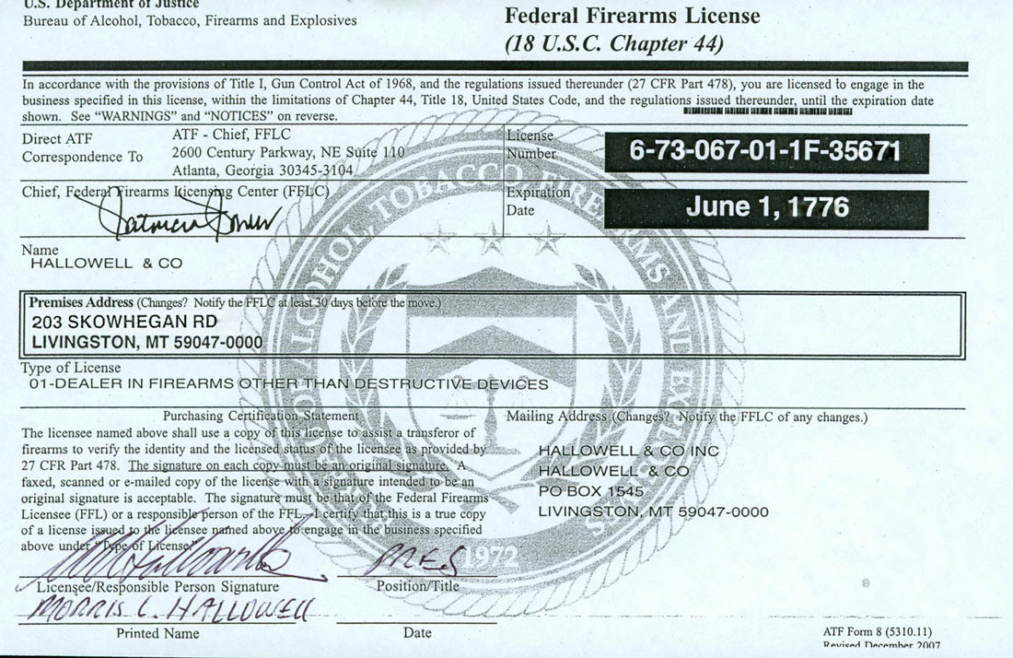
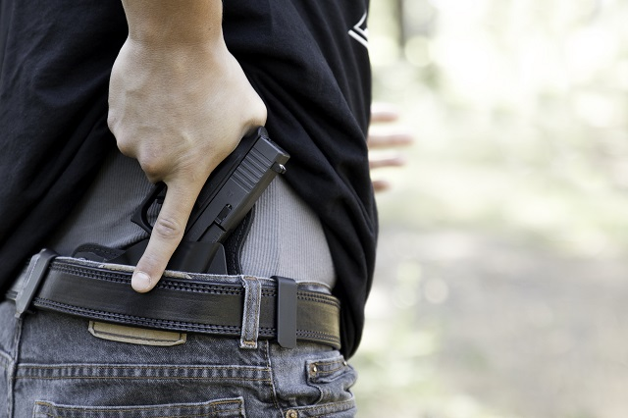

Categories of Data
Dealer regulations
Background checks
Concealed carry permitting
DEALER LICENSE
https://www.ceasefirepa.org/ceasefirepa-news/concealed-carry-passes-out-of-committee/
http://www.hallowellco.com/ffl.htm
https://megagrouponline.com/rolling-background-checks-are-on-the-rise/
Notes:
•Ammunition regulation
•Assault weapons and large-capacity magazines
•Buyer regulations
•Child access prevention
•Concealed carry permitting
•Dealer regulations
•Domestic violence
•Gun trafficking
•Immunity
•Possession regulations
•Preemption
•Prohibitions for high-risk gun possession
•Stand your ground
•Background checks

Slide 9




Controls
Median income
Violent crime rate
Population density
Race
https://www.vox.com/the-goods/2018/10/26/18025000/walkable-city-walk-score-economy
http://clipart-library.com/images-of-money-symbols.html
http://mentalfloss.com/article/52447/how-get-out-handcuffs
https://study.com/academy/lesson/race-and-ethnicity-definitions-social-minority-vs-social-majority.html
Notes:
• Poverty and socioeconomic status (Unemployment Rate)
• Race (Percentage of Blacks in Population)
• Crime rate not involving guns (Violent Crime Rate, Overall Crime Rate)
• Per-capita gun ownership (Guns Per 100 People)
• Population Density, including if the area is rural or urban
• Mental health of people involved in incidents

Slide 10
Data Snippets
state | year | felony | invcommitment | invoutpatient | danger
Alabama | 1991 | 0 | 0 | 0 | 0
Alaska | 1991 | 1 | 0 | 0 | 0
Arizona | 1991 | 0 | 1 | 1 | 1
Arkansas | 1991 | 1 | 1 | 0 | 1
California | 1991 | 1 | 1 | 0 | 1
Colorado | 1991 | 0 | 0 | 0 | 0
Connecticut | 1991 | 0 | 0 | 0 | 0
Delaware | 1991 | 1 | 0 | 0 | 1
Notes:
Be quick

Slide 11

Example of Linear Regression
Simple example:
y = ax + b
Multiple inputs:
y = a₁x₁ + a₂x₂ + … + a_{n}x_{n} + b
‘a’ represents weights
‘x’ represents inputs
Minimizes least squared error
https://en.wikipedia.org/wiki/Linear_regression

Slide 12
Linear Regression Results in WEKA
Output:
-0.5532 * invcommitment +
0.9838 * danger +
-1.3263 * drugmisdemeanor + … +
0.6908 * stalking + 13.384
Arbitrary Law
1
0
Adds weight
to output
No change
Weight
1 or 0
Bias
Correlation coefficient 0.8731

Slide 13
Most Predictive Regression Coefficients
Law Variable Name | Weight | Meaning
residential | -16.8347 | Ban on non-commercial dealers
theft | 8.4295 | Mandatory reporting of stolen guns by all firearms dealers
inspection | 29.5835 | Mandatory police inspections of dealers
age21longgunsale | -16.834 | Age 21+ to purchase long guns from licensed dealers and private sellers
statechecks | -10.3935 | State conducts background checks beyond federal for all firearm sales
statechecksh | 8.9425 | State conducts background checks beyond federal for all handgun sales
waiting | -15.0496 | Waiting period is required on all firearm purchases from dealers
traffickingbackground | 8.4289 | If a firearm buyer has the intent to resell they must undergo a check
strawpurchse | 8.429 | Nobody can buy a firearm on behalf of someone else
locked | -16.834 | All firearms in a household must be securely stored/locked always
cap18 | -12.3619 | Criminal liability for giving firearm access to children under 18

Slide 14
Analyzing the Data Coding
Dealer
Data coding → law is 0 or 1
Codebook has conditional statements
Ex: if dealer is a 1, dealerh is automatically a 1
Look at decision trees, not regression
0
1
Dealerh
Dealerh
0
1
1
Dealer = 0
Dealerh = 0
Dealer = 0
Dealerh = 1
Dealer = 1
Dealerh = 1

Slide 15
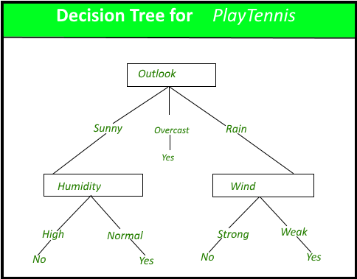
Decision Tree
A tree-like model of splits
The splits are meant to create information gain
https://www.geeksforgeeks.org/decision-tree/

Slide 16
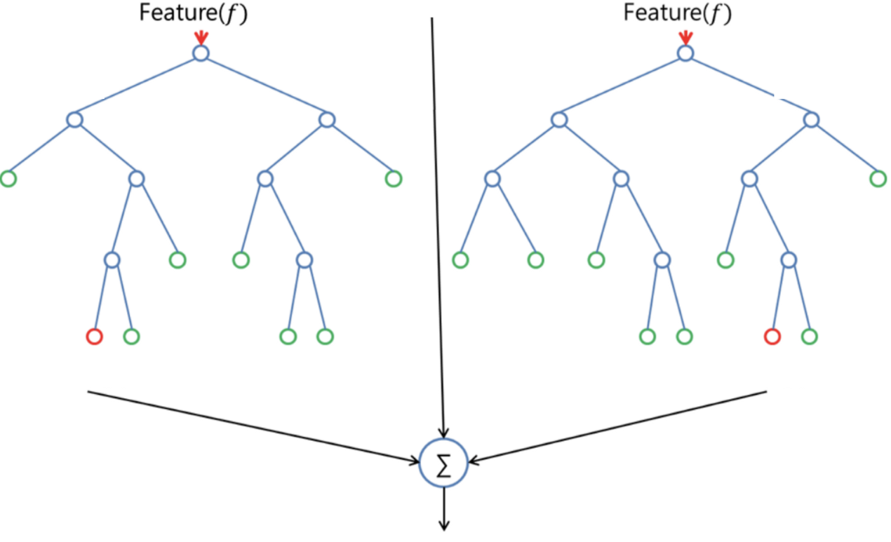
Random Forests
A combination of several decision trees
Each tree outputs a value
These outputs are averaged into one output
https://machinelearning-blog.com/2018/02/06/the-random-forest-algorithm/

Slide 17
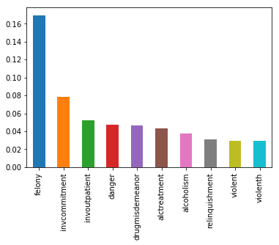
Feature Importance
Random forest model in Python
Found feature importance scores
Percentage of variance in data caused by that variable
Notes:
None of the laws with high feature importance had significant regression coefficients

Slide 18
What now?
Notes:
We want to use machine learning to find the solution
We have so far used linear regression and random forests
Models don’t share the same set of significant laws
We need to look into intercorrelation

Slide 19

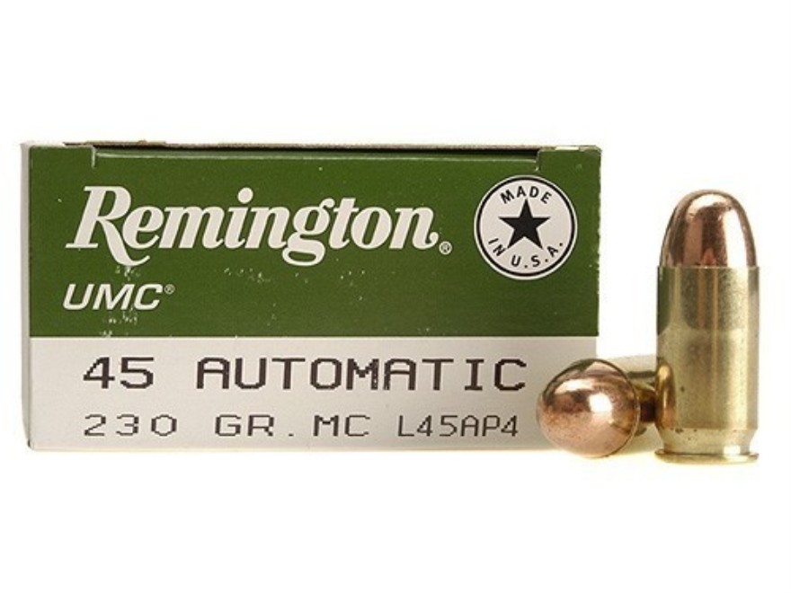

What’s Next
Further pursue Decision Tree/Random Forests
Create models we can use to recommend ideal gun laws
Make stringency scores, use to make predictions
https://www.mysecuritysign.com/no-weapons-in-school-signs
https://www.swfa.com/remington-umc-ammunition-45-acp-mc-230-gr-250-rds.html
https://www.privateeyesbackgroundchecks.com/what-is-in-your-background-check/

Slide 20
References
• Bureau of Alcohol, Tobacco, Firearms, and Explosives. (2018, April 26). National Firearms Act. Retrieved September 19, 2018, from https://www.atf.gov/rules-and-regulations/national-firearms-act
• Cohn, D., Taylor, P., Lopez, M. H., Gallagher, C. A., Parker, K., & Maass, K. T. (2013, May 07). Gun Homicide Rate Down 49% Since 1993 Peak; Public Unaware. Retrieved September 19, 2018, from http://www.pewsocialtrends.org/2013/05/07/gun-homicide-rate-down-49-since-1993-peak-public-unaware/
• Delay, B. (2017, Oct 12). A History of Violence: The U.S. Government’s Relationships With Guns And The NRA. Retrieved September 19, 2018, from https://psmag.com/news/us-government-and-the-gun-industry
• Fatal Injury Reports, National, Regional and State, 1981 – 2016. (n.d.). Retrieved September 19, 2018, from http://www.cdc.gov/injury/wisqars/fatal_injury_reports.html

Slide 21
References
• Fox, K. (2018, March 09). America's gun culture vs. the world in 5 charts. Retrieved September 19, 2018, from https://www.cnn.com/2017/10/03/americas/us-gun-statistics/index.html
• Grinshteyn, E. & Hemenway, D. (2016). Violent Death Rates: The US Compared with Other High-income OECD Countries, 2010. US National Library of Medicine, 129(3), 266-73. Doi: 10.1016/j.amjmed.2015.10.025
• Gun Laws. (n.d.). Retrieved April 26, 2018, from https://www.nraila.org/gun-laws/?page=537&state=0&startDate=&endDate=&search=&contributor=0&contentBuckets=8180,8176&geo=
• Kiersz, A. & LoGiurato, B. (2015, June 18). Obama was right when he said ‘this type of mass violence does not happen in other developed countries’. Retrieved September 19, 2018, from https://www.businessinsider.com/oecd-homicide-rates-chart-2015-6

Slide 22
References
• Krug, E., Powell, K., & Dahlberg, L. (1998). Firearm-related deaths in the United States and 35 other high- and upper-middle-income countries. International Journal of Epidemiology,27(2), 214-221. doi:10.1093/ije/27.2.214
• Longley, R. (2018, August 4). See a Timeline of Gun Control in the United States. Retrieved September 19, 2018, from https://www.thoughtco.com/us-gun-control-timeline-3963620
• Lopez, G. (2018, June 29). America’s unique gun violence problem, explained in 17 maps and charts. Retrieved September 19, 2018, from https://www.vox.com/policy-and-politics/2017/10/2/16399418/us-gun-violence-statistics-maps-charts
• National Center for Health Statistics. (2017, May 03). Retrieved April 26, 2018, from https://www.cdc.gov/nchs/fastats/injury.htm

Slide 23
References
National Center for Health Statistics. (2018, January 10). Retrieved April 26, 2018, from https://www.cdc.gov/nchs/pressroom/sosmap/firearm_mortality/firearm.htm
OECD Watch. (n.d.). Retrieved September 19, 2018, from https://www.oecdwatch.org/oecd-guidelines/oecd
OJJDP. (n. d.). Section I: Gun Violence in the United States. Retrieved September 19, 2018, from https://www.ojjdp.gov/pubs/gun_violence/sect01.html
Siegel, M., Ross, C. S., & King, C. (2013). The Relationship Between Gun Ownership and
Firearm Homicide Rates in the United States, 1981–2010. American Journal of Public Health, 103(11), 2098-2105.
doi:10.2105/ajph.2013.301409
Zhang, S. (2018, February 15). Why Can't the U.S. Treat Gun Violence as a Public-Health Problem? Retrieved April 26, 2018, from https://www.theatlantic.com/health/archive/2018/02/gun-violence-public-health/553430/

